Slide 1
Online Shopper
Purchase Prediction
Zul Fauzi Abas

Slide 2
The Problems
In digital age, understanding online shopper behavior is crucial for e-commerce success.
Why this Matters?
Accurate predictions can improve customer interactions and shopping experiences.

Slide 3
Objective & Goals
Objective: To build a model that predict purchases from browsing behavior.
Goal: To surpass baseline accuracy by 10%.
Output: A Jupyter Notebook with model with the predictive model and insights.

Slide 4
The Dataset
Source: Kaggle.
Focus: Browsing behavior features.
Assumption: Data mirrors online shopper trends and behaviors.

Slide 5
The Approach
EDA: Identify patterns, outliers, and skewness.
Data Processing: Address skewness, outliers, and class imbalance.
Modeling: Experiment with Logistic Regression, KNN, Decision Trees, Random Forests.
Tuning: Optimize the best model.

Slide 6
EDA Insight
Outliers and skewness were identified across features.
Class imbalance observed, affecting model bias.
Negative correlation in some features could impact purchase predictions.

Slide 7
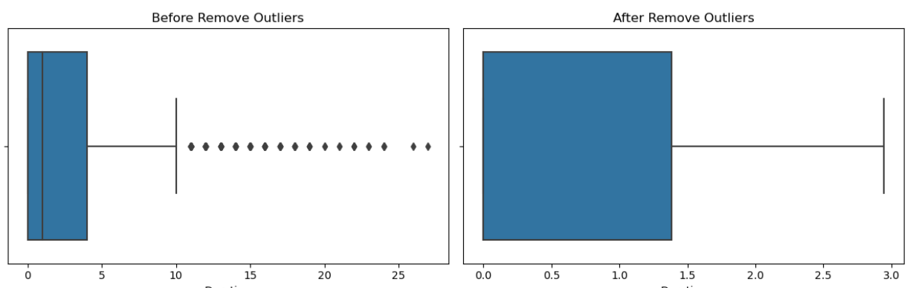
Data Preparation
Outliers? Detect & remove using IQR method
Figure 1. 'Administrative' feature; before and after removing outliers

Slide 8
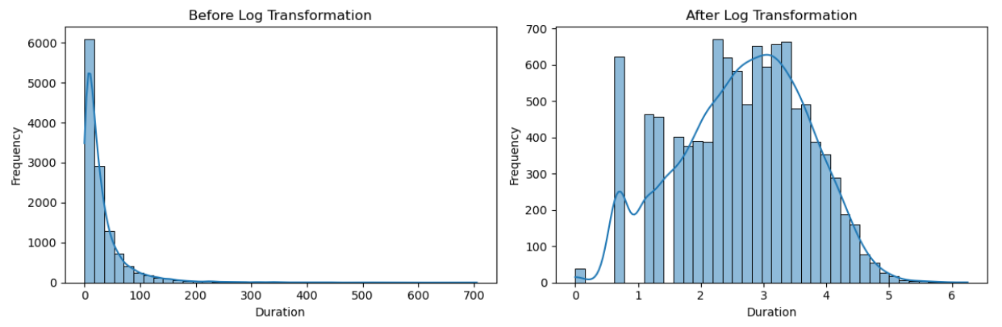
Skewness? Applied log transformation to features
Figure 2. 'Product Related' feature; before and after log transformation

Slide 9
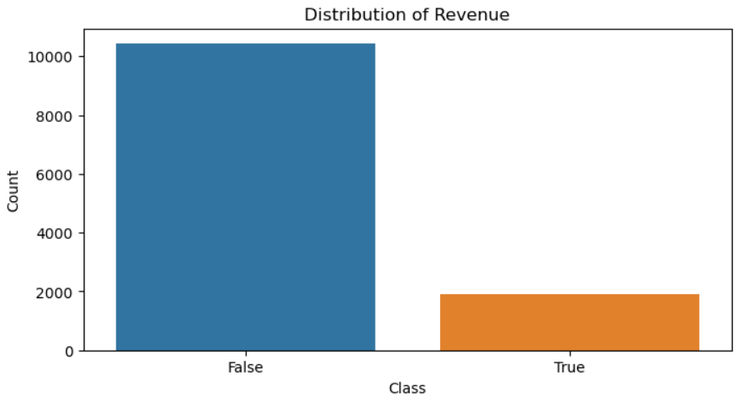
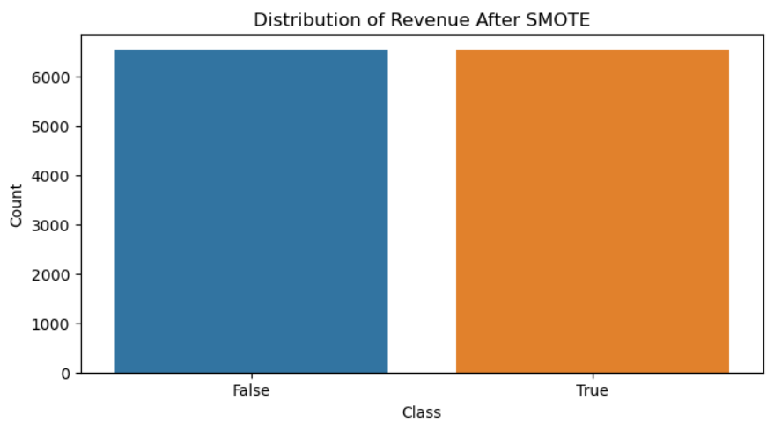
Class Imbalance? Corrected using SMOTE
Figure 3. 'Revenue' feature; before and after applying SMOTE

Slide 10
Modeling Strategy
Models tested on training data: Logistic Regression, KNN, Decision Trees, Random Forests.
Accuracy chosen as the performance metric.
Selection for tuning is based on classification performance.

Slide 11
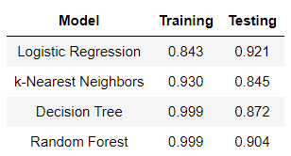
Model Performance
Logistic Regression achieved the best balance, avoiding overfitting.
Table 1. Accuracy of Model on Training
& Testing Set

Slide 12
Tuning and Results
Post-tuning, accuracy improved to 84.3%, exceeding our goal.

Slide 13
Insights and Predictions
Patterns in browsing data accurately indicate purchase likelihood.
The model's predictions can enhance online retail strategies.

Slide 14
Conclusions and Next Steps
Achievement: Our model significantly improves prediction accuracy.
Next steps involve refining the model and exploring additional applications.
Complete analysis link: https://github.com/mzfauzi89/Capstone-Project

Slide 15
Thank you

